Slide 3
Stages of communications
Foundation. This was the foundation of electrical engineering and radio wave transmission, and owes a great deal to the founding fathers of electrical engineering such as Coulomb, Ampère, Ohm, Gauss, Faraday, Henry and Maxwell, who laid down the basic principles of electrical engineering.
Electronics revolution. This brought increased reliability, improved operations, improved sensitization and increased miniaturization.
Desktop computer revolution. This accelerated the usage of digital communication and has finally integrated all forms of electronic communications: text, speech, images and video.
Modern communication. This increased the ways of connections, and has steadily increased the speed of the connection, such as from satellite communications, local area networks and digital networks. Along with the integration of text, speech, images and video has came the integration of different type’s carriers.

Slide 4
History
Automated telephone switching.
Radio transmission.
Trans-continental cables.
Satellites.
Digital transmission and coding.
Fiber-optic transmissions.
The Internet.

Slide 6
Base Bit rates
Human teletype:
Transfer rate = 7.5 (characters per second) x 8 (bits per character) = 60 bps
120 bps, 240bps, 480bps, 960bps, ...
Telephone network ...
64 kbps ... 8 bits per sample at 8 kHz.

Slide 7
Variations in Communication Systems
Bandwidth contention, bandwidth sharing or reserved bandwidth.
Virtual path, dedicated line or datagram.
Global addressing, local addressing or no addressing.

Slide 8
Communication Mechanisms
Simplex communication. Only one device can communicate with the other, and thus only requires handshaking lines for one direction.
Half-duplex communication. This allows communications from one device to the other, in any direction, and thus requires handshaking for either direction.
Full-duplex communications. This allows communication from one device to another, in either direction, at the same time. A good example of this is in a telephone system, where a caller can send and receive at the same time. This requires separate transmit and receive data lines, and separate handshaking for either direction.

Slide 9
Serial or Parallel?

Slide 10
Data Transfer Rate
T
Clock frequency (Hz)

Slide 11
Introduction
Data formats and Operators

Slide 12
Binary and Hex
What is 0010 1011 in decimal?
What is 93 in binary?
What is 0010 1011 in hex?
Link

Slide 13
Boolean Logic Operations

Slide 14
Bit shifts

Slide 15
Bit masking
Link Link
Val 0 0 1 1 0 1 0 1
& 0 0 0 0 1 1 1 1
------------------------------
0 0 0 0 0 1 0 1

Slide 16
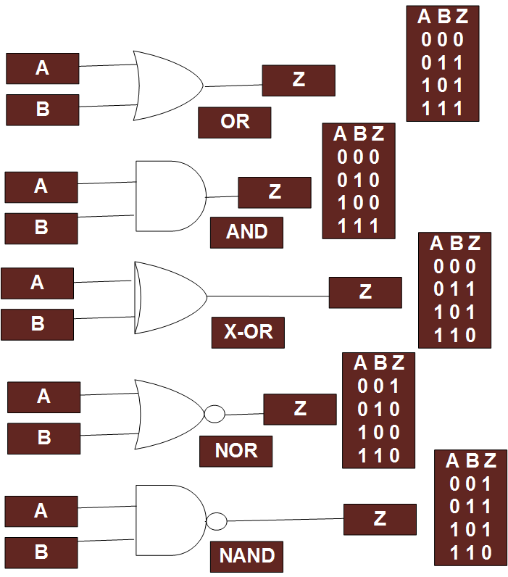
Logic gates
Link
Link

Slide 17
Introduction
Matrix operations

Slide 18
Matrix operations
Single column (n×1)
Single row (1×m)
Multiple row and column (n×m)
Multiple matrices
Dot product

