Slide 1
Cryptocurrency Risks
- Protecting the Wallet Prof Bill Buchanan OBE http://asecuritysite.com/crypto10 http://asecuritysite.com/encryption

Slide 2
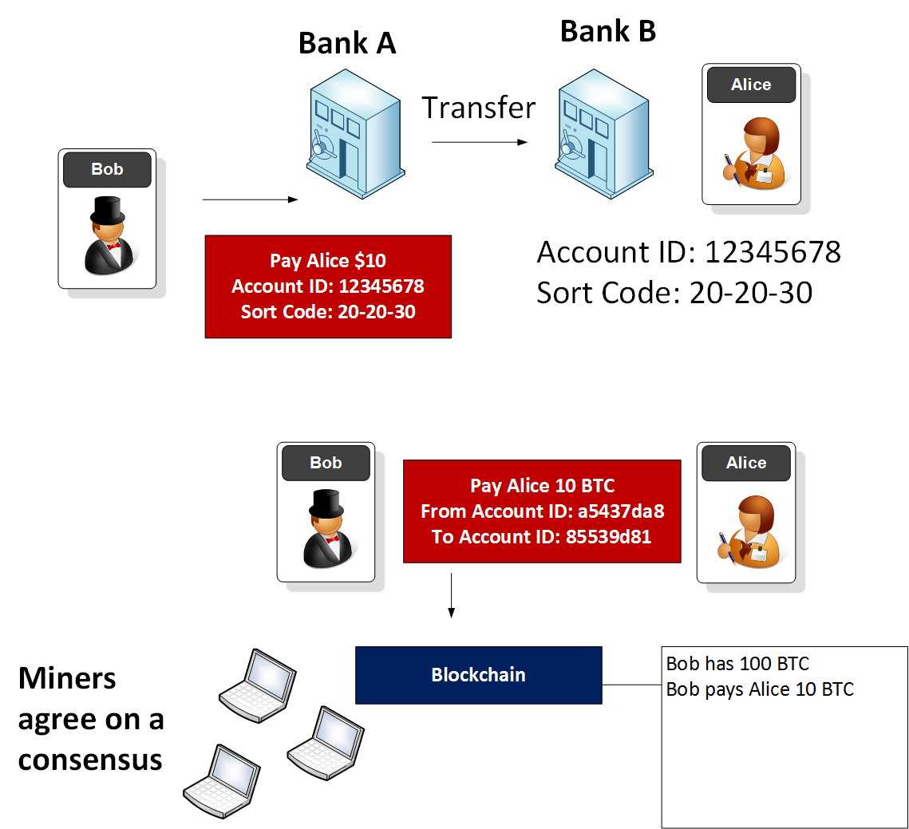
Payments

Slide 3
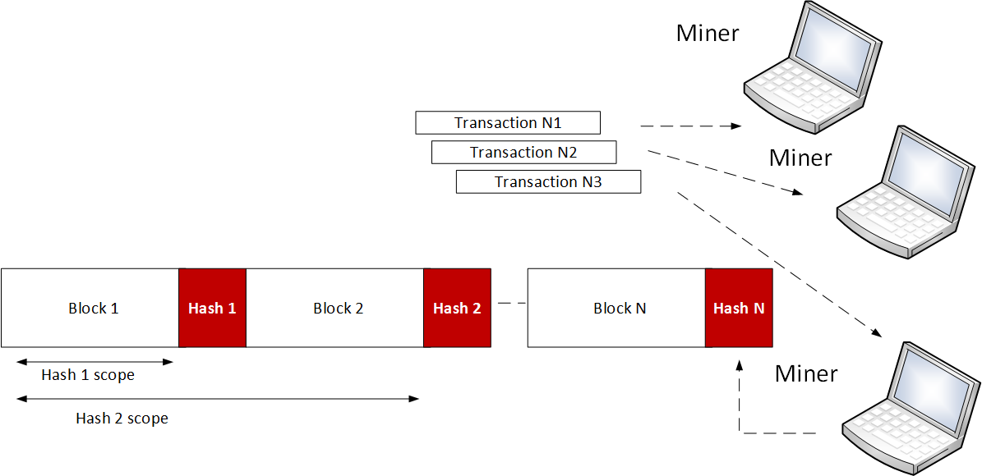
Mining process

Slide 4
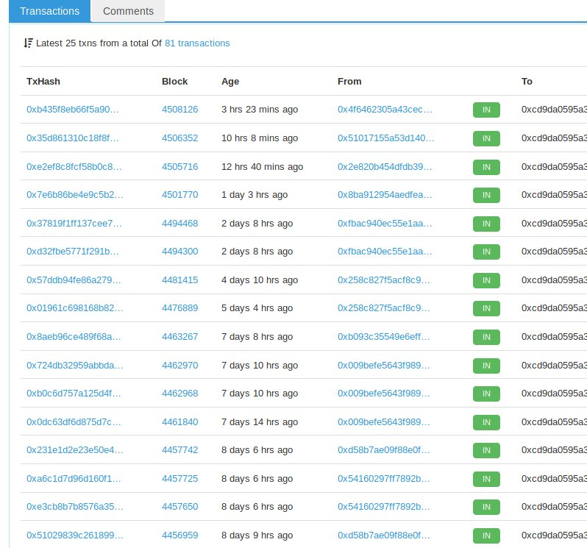
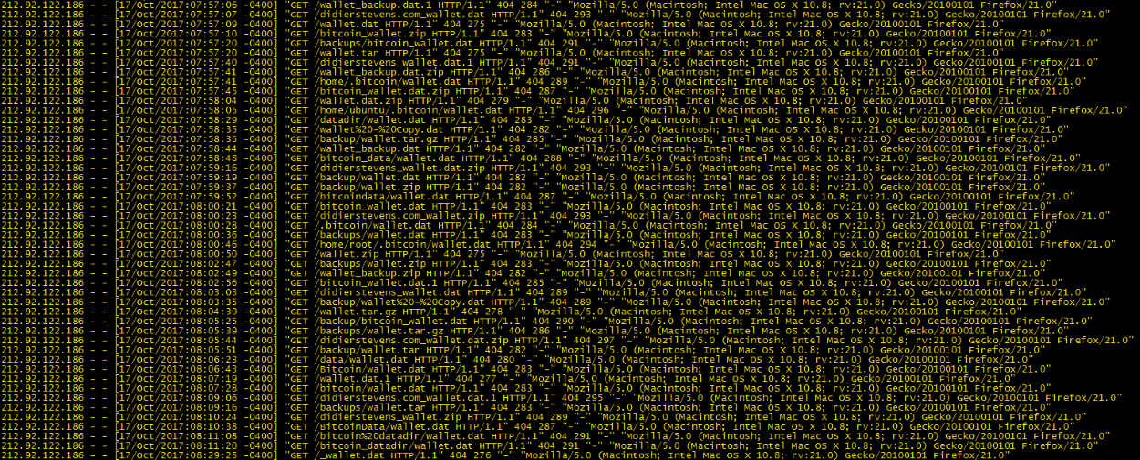
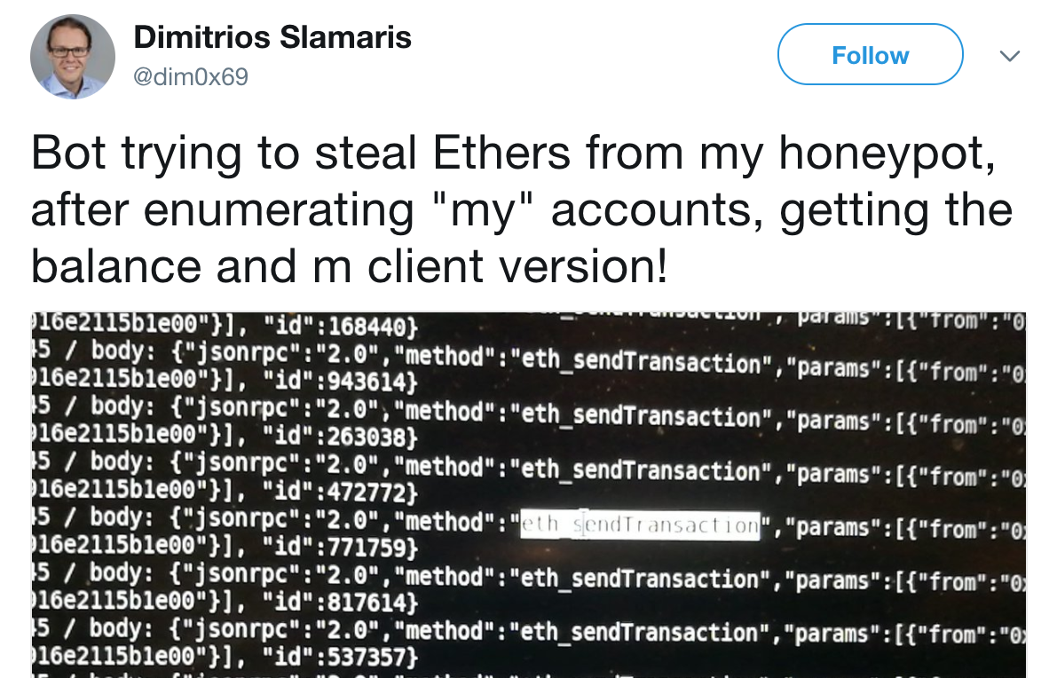
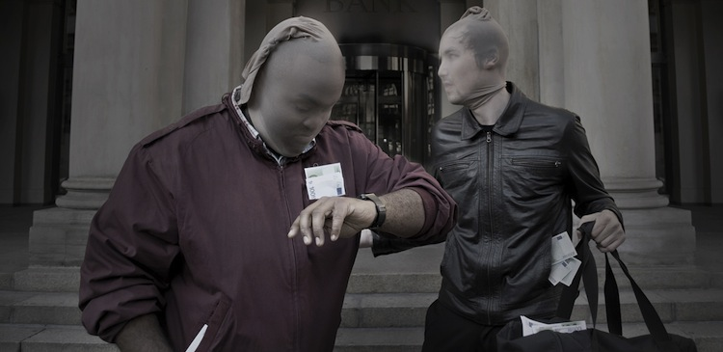
The Most Profitable Crime?
wallet - Copy.dat
wallet.dat
wallet.dat.1
wallet.dat.zip
wallet.tar
wallet.tar.gz
wallet.zip
wallet_backup.dat
wallet_backup.dat.1
wallet_backup.dat.zip
wallet_backup.zip

Slide 5
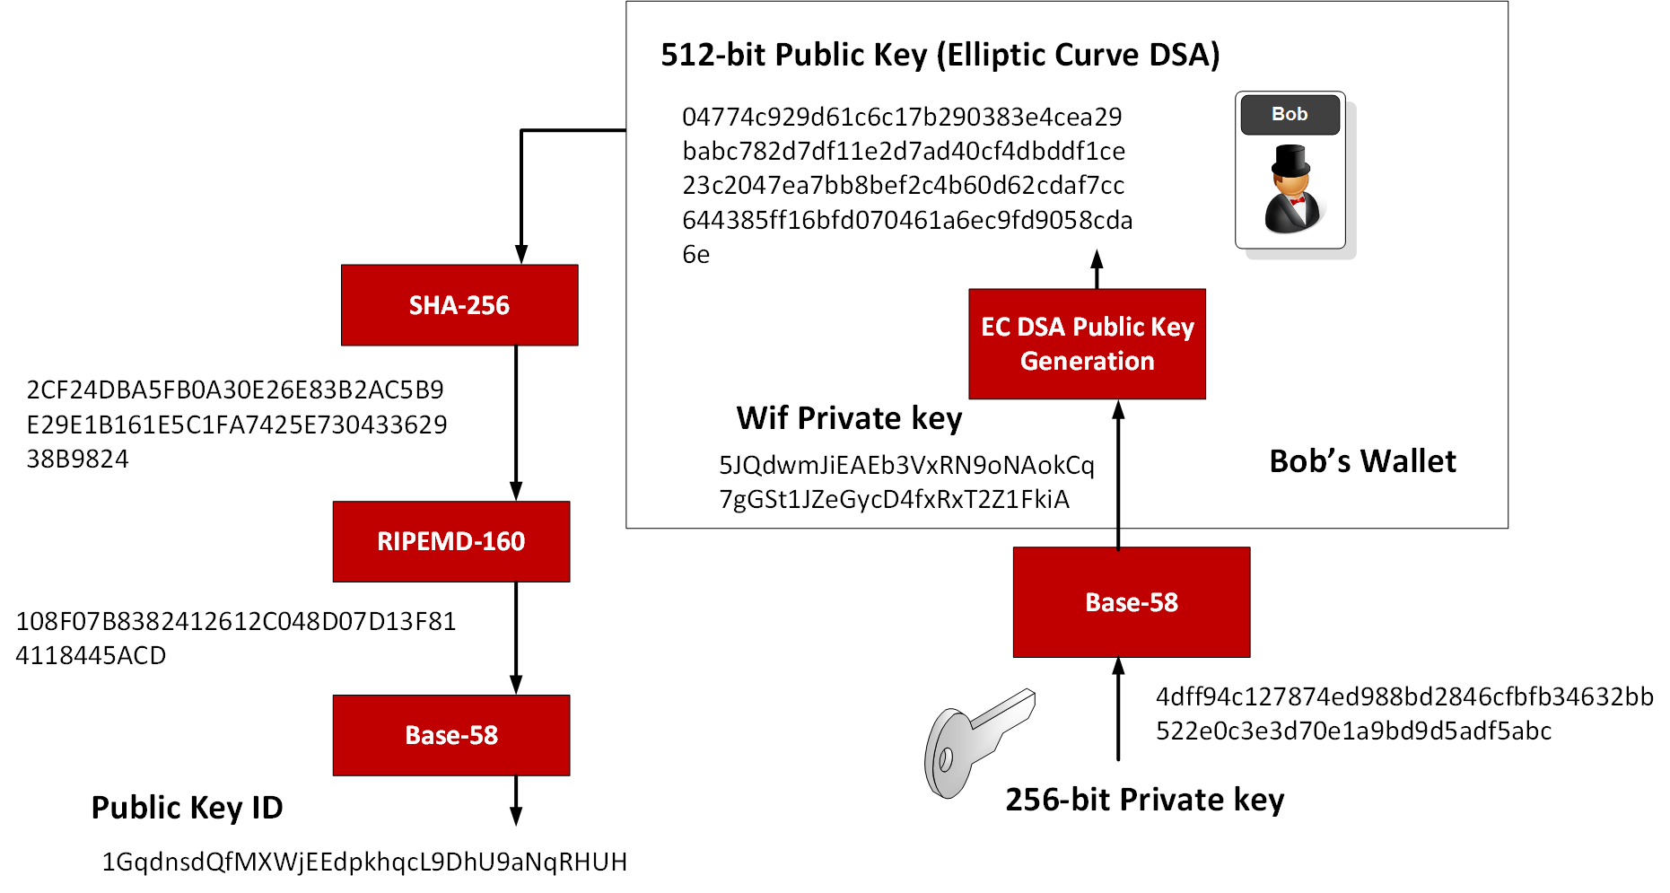
Bitcoin Wallet and Addresses

Slide 6
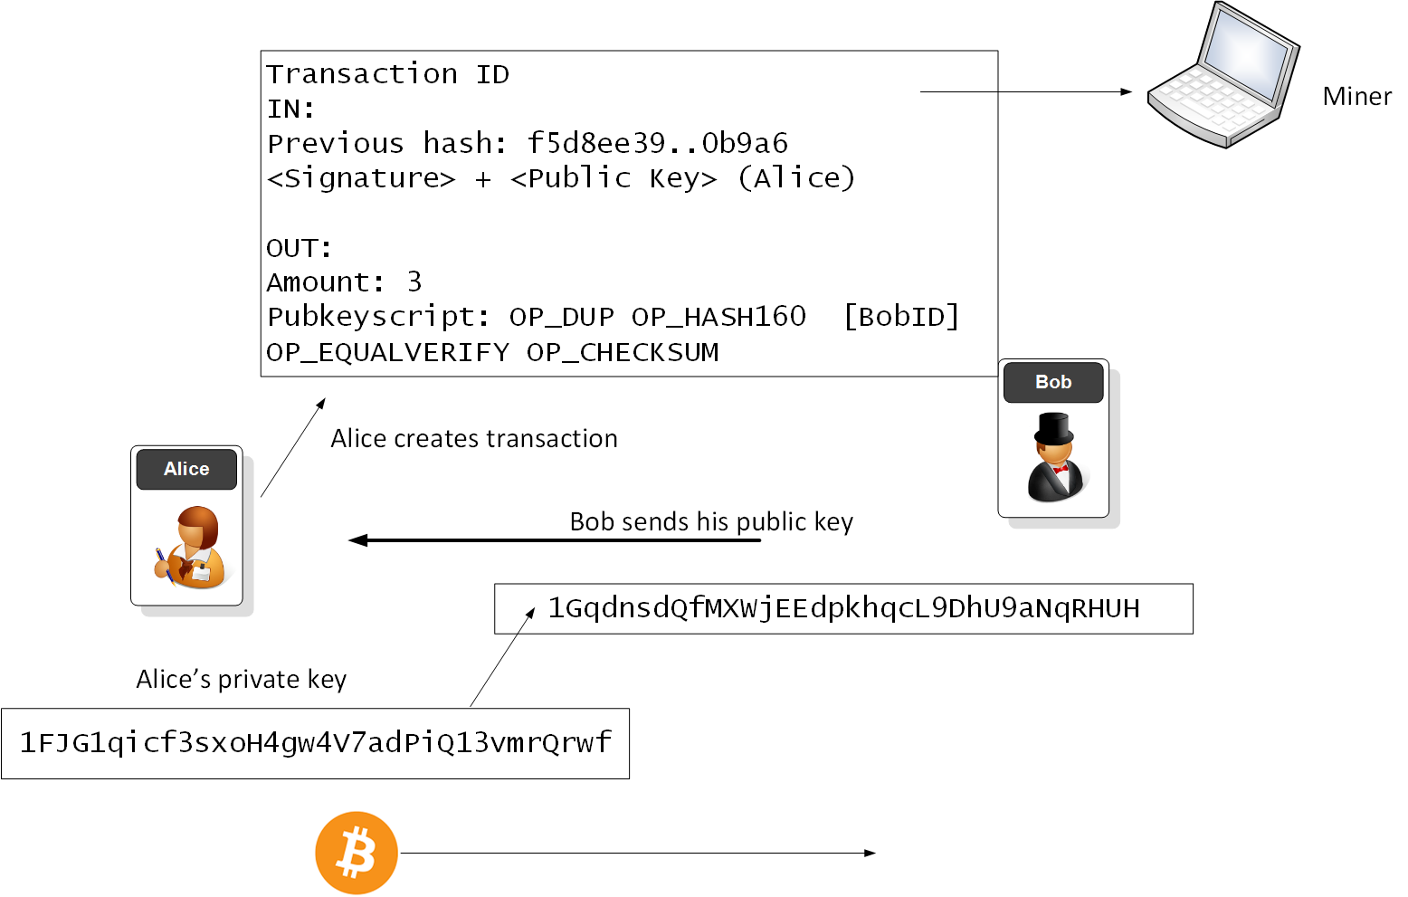
Bitcoin transaction

Slide 7
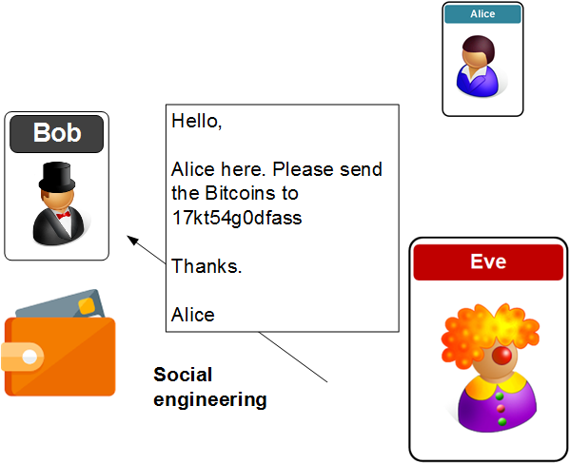
Social Engineering risk

Slide 8
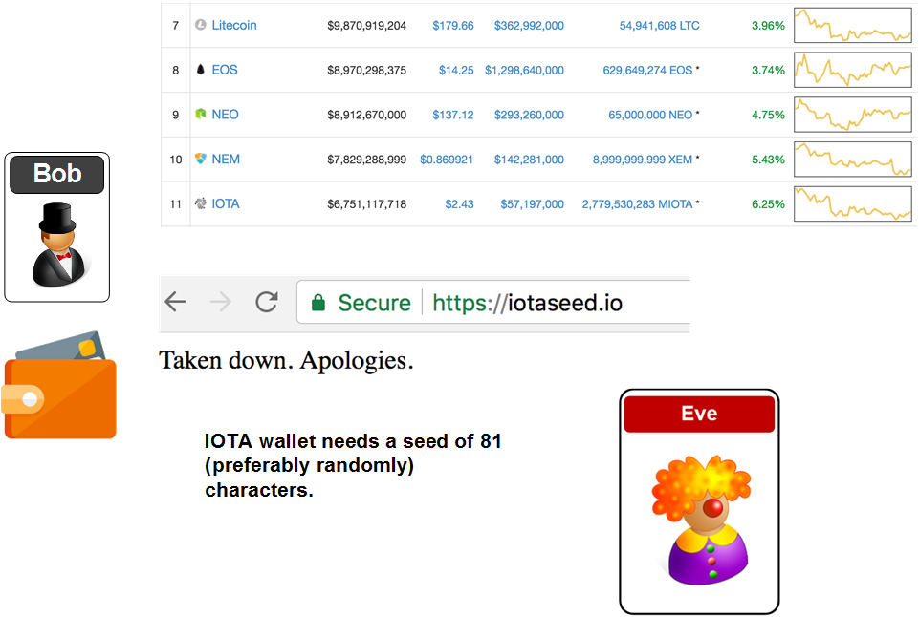
Wallet creation trick

Slide 9
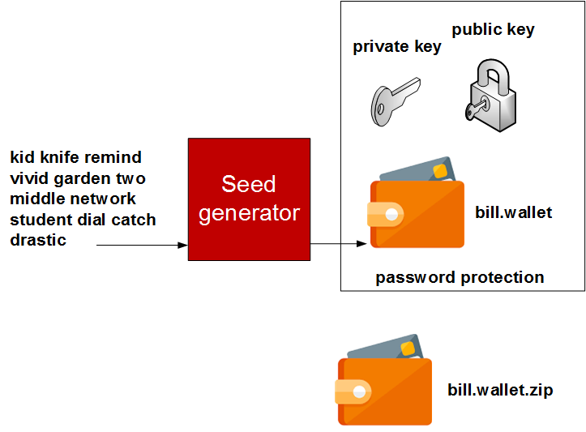
Bitcoin wallet creation

Slide 10
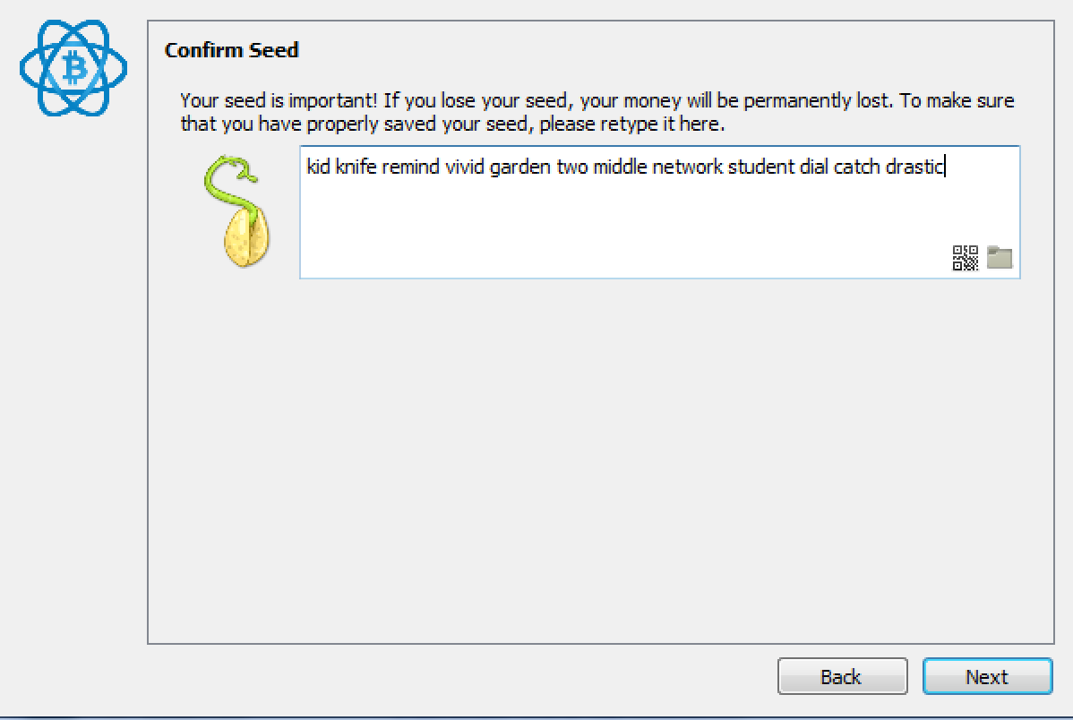
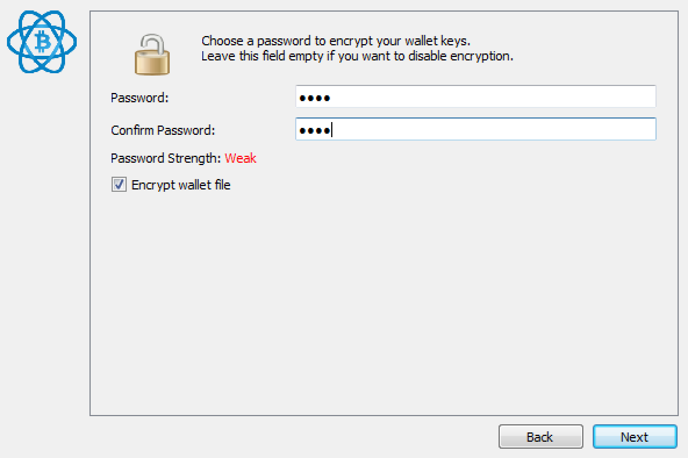
Bitcoin wallet creation

Slide 11
Bitcoin recovery
D:\btcrecover-master>python btcrecover.py --passwordlist test.txt --wallet wallet.data
Starting btcrecover 0.17.10 on Python 2.7.13 32-bit, 16-bit unicodes, 32-bit ints
Wallet difficulty: 1024 PBKDF2-SHA512 iterations + ECC
Using 6 worker threads
0 of 2 [----------------------------------------------] 0:00:00, ETA: --:--:--
Password found: 'bill'

Slide 12
Bitcoin recovery
Tokens
bill
test
edinburgh
Takes tokens and adds them eg billtest, billedinburgh, testedinburgh.
Mutual exclusion
bill
test test1 test2
edinburgh
Generates billtest, billtest1, billtest2, and not billtesttest1

Slide 13
Bitcoin recovery
Required Tokens (+ to require string in all passwords)
+bill
test
edinburgh
Takes tokens and adds them eg billtest, billedinburgh, and not testedinburgh.
Anchor (start of the string “$” at the end)
^bill
test test1 test2
edinburgh
Generates billtest, billtest1, billtest2, and not edinburghbill

Slide 14
Bitcoin recovery
Positional anchors
^2^bill
test
edinburgh
Takes tokens and adds them eg testbill, edinburghbill
Numbers
bill%d
Takes tokens bill1, bill2, etc

Slide 15
Bitcoin recovery
Options
--password-list
--max-tokens
--typos-capslock - tries the whole password with caps lock turned on
--typos-swap - swaps two adjacent characters
--typos-repeat - repeats (doubles) a character
--typos-delete - deletes a character
--typos-case - changes the case (upper/lower) of a single lette

Slide 16
Bitcoin password best practice
• At least 12 Characters.
• Always include Numbers, Symbols, Capital Letters, and Lower-Case Letters.
• Don’t use Dictionary Word or Combination of Dictionary Words.
• Don’t Rely on Obvious Substitutions.

Slide 17
Cryptocurrency Risks Prof Bill Buchanan OBE http://asecuritysite.com/crypto10 http://asecuritysite.com/encryption

